Slide 1
The Impact of COVID-19 Pandemic on Immigrant and Refugees Globally and in the United States
Carmen Monico, MS, MSW, PhD, Associate Professor
Jovani Mendez-Sandoval, BSBA student
Neema Olagbemiro, MPH, PhD student
Moderator: Miguel Rojas Sotelo, Duke University
NC Conference on Latin American Studies 2021
February 20, 2021
Notes:
Dr. Monico

Slide 2
Activity at Prep – to think before starting
How does the presentation refer to your personal experience?
How does the presentation refer to the professional work you do?
What are the key takeaways you have from this presentation?
How do you plan to use what you have learned today?
Notes:
Neema will copy and paste on chat

Slide 3
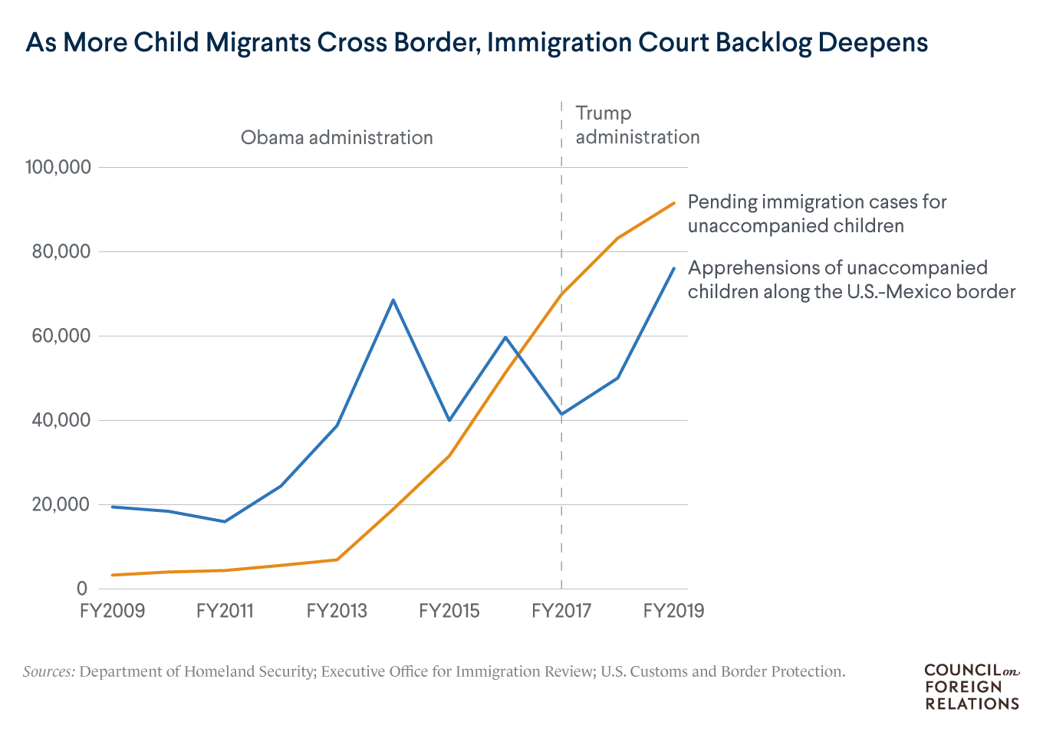
Humanitarian crisis at the U.S. Southern border
Source: Council on Foreigh Relations. U.S Detention of Child Immigrants. https://www.cfr.org/backgrounder/us-detention-child-migrants
Notes:
Jovani
Graph - https://www.cfr.org/backgrounder/us-detention-child-migrants
This data is from the Council of Foreign Relations about the U.S Homeland Security immigration court backlog
Immigration authorities apprehended a record-setting 76,020 unaccompanied minors at or near the U.S.-Mexico border during the 2019 fiscal year, an increase of 52 percent over 2018 (Cheatham, 2020).
The accumulation of pending cases in immigration cases in the Obama administration but a rapid increase in the Trump administration especially in the year 2017.
As a result, more children are under government custody in office of refugee resettlement
Family members accounted for about a third (35%) of all border apprehensions in 2018 – the highest share within the past seven years (Bialik, 2020)

Slide 4
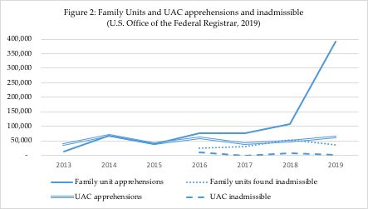
Source: Monico & Mendez-Sandoval, Geneology (2019)
Notes:
Jovani
Talk about apprehensions first, say UACs but later say unaccompanied minors. An increase in unaccompanied minors since the start of the pandemic because parents are noting the U.S has certain protections of children. This graph and trends are precovid and we will discuss it later.
Graph depicts the increase in the apprehension of unaccompanied alien minors (UACs) and family units (parents & children) in the last few years with those found “inadmissible” or without merit to be admissible to enter the U.S.
Climate change refugees → The spike of Family unit apprehensions because of hurricane Maria that affected central america, political instability and the introduction of the build the wall act in the trump administration in 2018.
Inadmissible barriers when seeking asylum which is a right immigrants have when crossing a border.
Those found “inadmissible” may be due to health reasons (ex. mental health, heart condition), to having a criminal background (ex. traffic offense), to being considered a threat to nation’s security (ex. suspected gang member), to likely becoming a public charge (ex. no health insurance), to being found to have committed fraud or misrepresentation (ex. using false ID or SSN), or to having a record of prior removals (prior deportation)
In fiscal year 2019, more than 527,000 noncitizen family unit members (children under 18 and their parents or legal guardians) were apprehended at or between U.S. ports of entry along the southwest border—a 227 percent increase over fiscal year 2018 (Bielby, 2020).
https://www.humanitarianresponse.info/sites/www.humanitarianresponse.info/files/documents/files/20191202-ocha-desastres_naturales2.pdf

Slide 5
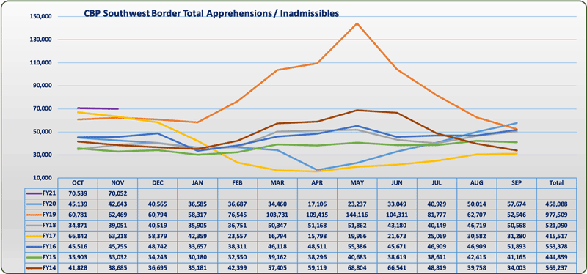
Southwest Border Migration, Fiscal Years 2014-2021
Source: U.S. Customs and Border Protection (CBP) 2020. Southwest Land Border Encounters. https://www.cbp.gov/newsroom/stats/southwest-land-border-encounters
Notes:
Jovani
With more than 400 Immigration Executive Actions during the Trump Administration, experts believe the U.S. immigrant system has been profoundly transformed (Sawyer & Wagner, 2020), resulting in restrictive and punitive immigrant policies and practices like incarceration and deportation levied against those seeking asylum and help in the U.S.
The implementation of zero-tolerance immigration policies under the Trump Administration resulted in a growing immigrant population being detained after crossing the U.S.-Mexico border with the use of border patrol inspections, ICE raids, and other immigration crackdown operations
These immigration policies have had a significant effect on overall immigration trends, as shown in data from the fiscal years (FY) of 2014, 2015, and 2016 compared to the first two months of FY2021(i.e., October and November 2020) as seen in graph.

Slide 6
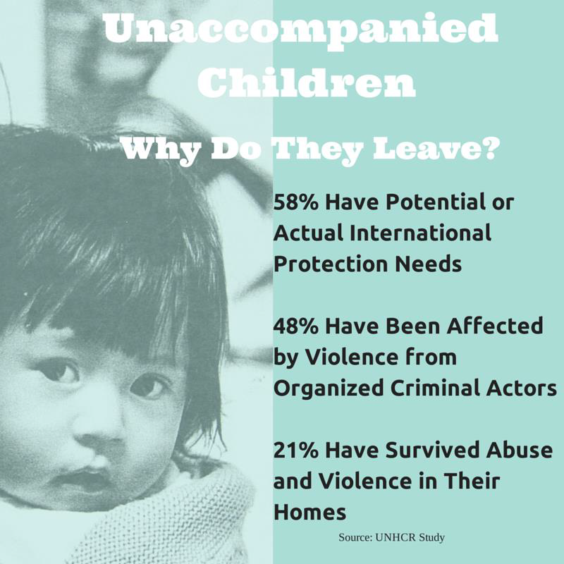
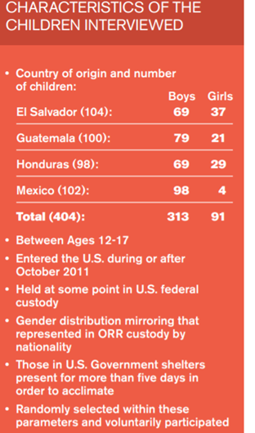
Source: UNHCR 2014 Report: Children on the Run - Unaccompanied Minors: Humanitarian Situation at US Border https://www.unhcr.org/en-us/children-on-the-run.html
Notes:
Dr. Monico
United High Commissioner on Refugees (UNHCR) documented a 1,185% increase in the number of asylum applications from citizens of these three countries in Mexico, Panama, Nicaragua, Costa Rica and Belize, combined, from 2008 to 2014. UNHCR Washington conducted individual interviews with 404 unaccompanied or separated children – approximately 100 from each country – who arrived to the U.S. during or after October 2011 and, in the context of the current regional and national environments and the tremendous number of displaced children arriving to the U.S. from these four countries, analyzed the children’s responses in order to answer two questions: Why are these children leaving their countries of origin? Are any of these children in need of international protection?

Slide 7
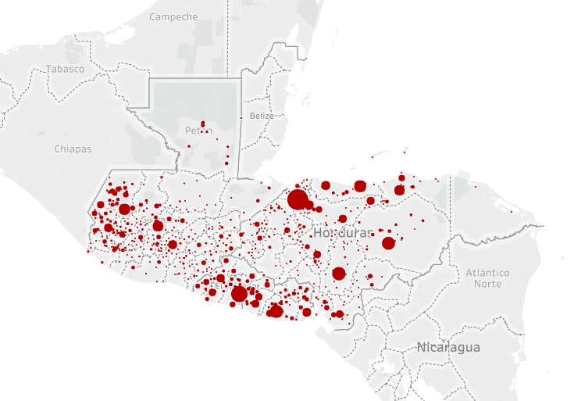
Origins of immigrant children and their families: History of war and drug trafficking/gangs
Source: Lawfare. Who’s Really Crossing the U.S. Border, and Why They’re Coming. https://www.lawfareblog.com/whos-really-crossing-us-border-and-why-theyre-coming
Notes:
Dr. Monico - You can see in this map showing the countries and towns where most of the immigrant children and their families crossing the U.S.-Mexico border are coming from. As you can see, they’re mostly from the Northern Triangle Central American Countries. In El Salvador, they come from throughout the country but a large majority are from San Salvador Capital city and surrounding departments (where gangs have control of many low-income neighborhoods), and from Usulutan/San Miguel (where I am from and worked), historically a war zone prior to the Peace Accords. In Guatemala, where 43.75% of the population self-identify as members of one of the 22 Mayan groups to the Garífuna, Xinca or Creole (Afrodescendants) which represent less than 1 % of the population). People come from the capital city and surrounding areas (where people of Kaqchikel origin live and in some zones there is a lot of gang activity) and the Western Highlands (which was most hard hit during the civil war and where I conducted research and took students for study abroad to engage with K’iche’ and Mam communities. In Honduras, which includes many from the region close to the border with Guatemala, where Garifunas (Afrodescendants) also reside and the Chʼortiʼ people that live in the Eastern Highlands of Guatemala and other indigenous groups in Honduras. Recall that the war killed 80,000 and displaced more than a million, 200,000 Guatemalans were killed during the Guatemalan Civil War, and not long ago, Honduras became the country with the highest murder rate in a non-war country in the world. Although not everyone that arrives at the U.S.-Mexico border is of indigenous origin, there is a good representation of some of these ethnic groups for whom often no interpreting services are available.

Slide 8
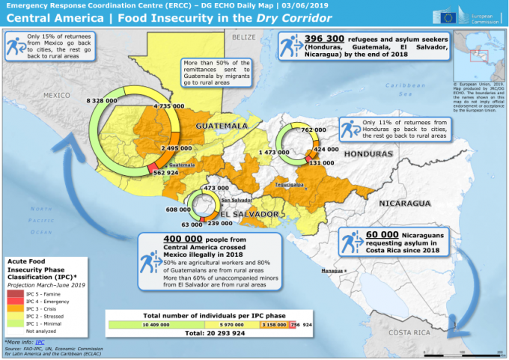
Notes:
Dr. Monico
As shown in the graph, the acute food insecurity phase classification (IPC) shows that many areas in the 3 C.A. countries in the Northern Triangle are either stressed or in crisis - there are many overlaps with the map I showed earlier about where those apprehended at the border are coming from. These are 2018 stats, so more likely the number of refugees and asylum seekers are higher by now, in spite of the pandemic, being food insecurity in the Dry Corridor a migration cause getting gaining greater weight.
According to the United Nations Office for the Coordination of Humanitarian Affairs “Drought is the disaster which affects the highest number of people in the region. Crop yield reductions of 50-75 per cent in central and eastern Guatemala, southern Honduras, eastern El Salvador and parts of Nicaragua. In these countries (known as the Dry Corridor), 8 out of 10 households in the communities most affected by drought resort to crisis coping mechanisms.”
https://www.humanitarianresponse.info/sites/www.humanitarianresponse.info/files/documents/files/20191202-ocha-desastres_naturales2.pdf
A 2017 USAID report stresses that “Honduras, one of the poorest countries in the Western Hemisphere, is vulnerable to climate change due to its high exposure to climate-related hazards (hurricanes, tropical storms, floods, droughts, landslides) that devastate crops and critical infrastructure. In 1998, Hurricane Mitch destroyed an estimated 70 percent of the country’s crops and infrastructure, causing more than 10,000 deaths and $3 billion in damage, significantly setting back Honduras’ development process. Honduras has a high rural population (more than 50 percent), of which 65 percent lives in poverty. The rural poor depend on rainfed agriculture as their principle livelihood and are concentrated in the southern and western regions, known as the Dry Corridor, where food insecurity has become a recurrent issue; 58 percent of children under five suffer from chronic undernutrition. In urban areas, migration from rural areas and population growth have pushed settlements into hazard-prone zones that lack water management systems, resulting in frequent flooding and water scarcity in major cities and towns including,Tegucigalpa, San Pedro Sula, La Ceiba, Choloma and Tela (USAID Climate Risk Profile, 2017). https://climateknowledgeportal.worldbank.org/country/honduras/vulnerability

Slide 9
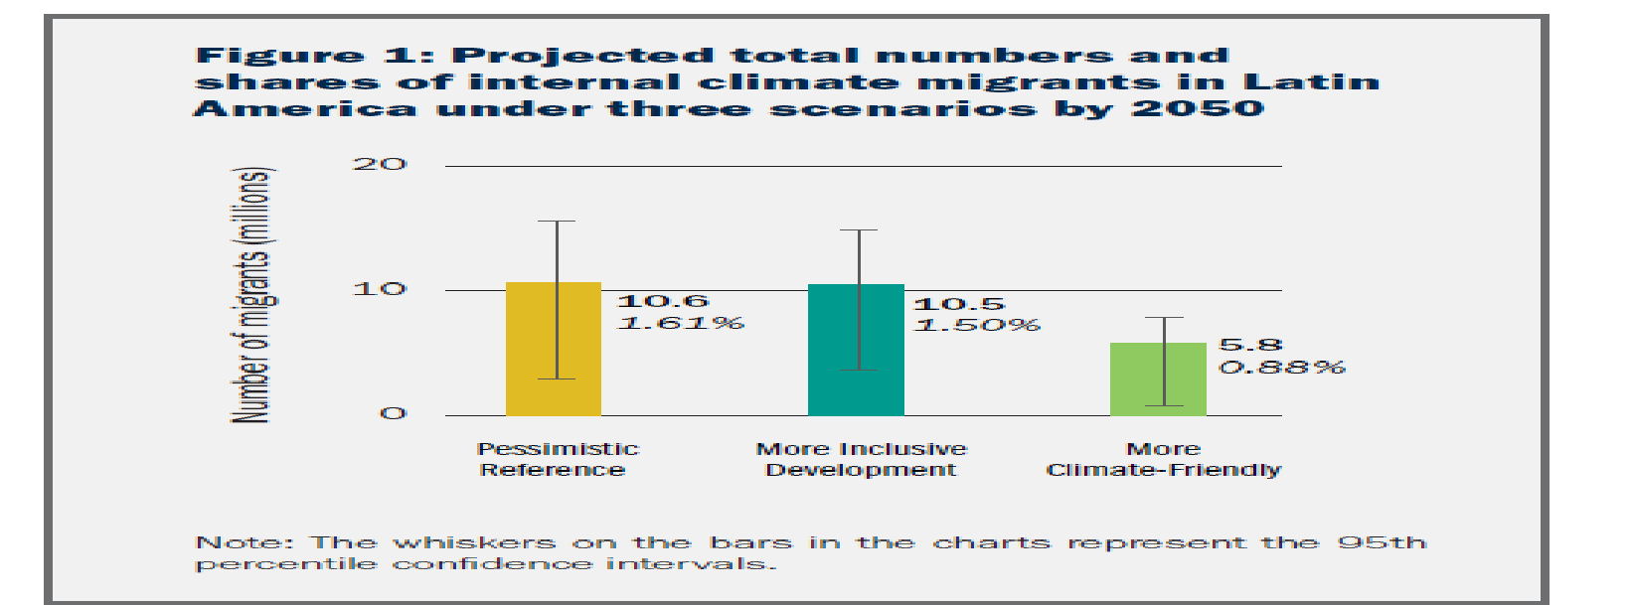
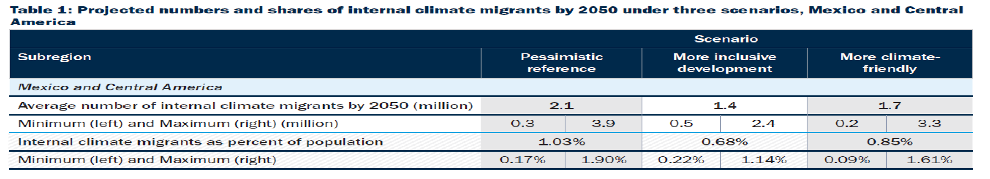
Groundswell: Preparing for Internal Climate Migration
(World Bank, 2018)
Notes:
Dr. Monico
WB report: Climate change is emerging as a potent driver of internal migration. The report Groundswell: Preparing for Internal Climate Migration (2018) projects that in Latin America, “internal climate migrants” could number over 17 million, representing up to 2.6 percent of the region’s total population. Climate migrants will move from less viable areas with lower water availability and crop productivity and from areas affected by rising sea level and storm surges. The poorest and most climate vulnerable areas will be hardest hit. There could add up to a high of 17.1 million by 2050 under the pessimistic reference scenario, or 2.6 percent of the region’s total population (Figure 1). Under the more inclusive development scenario, there will be up to 16.2 million internal climate migrants—0.9 million fewer migrants compared to the pessimistic reference scenario. In the more climate-friendly scenario, there will be up to 9.4 million climate migrants.
Source: The World Bank (2018). Groundswell: Preparing for Internal Climate Migration. Policy Note #3.http://documents1.worldbank.org/curated/en/983921522304806221/pdf/124724-BRI-PUBLIC-NEWSERIES-Groundswell-note-PN3.pdf

Slide 10
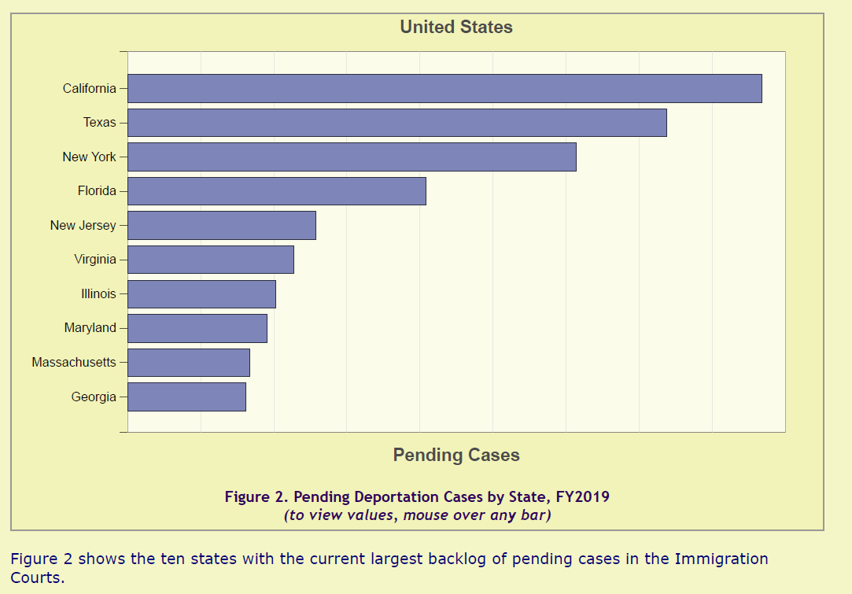
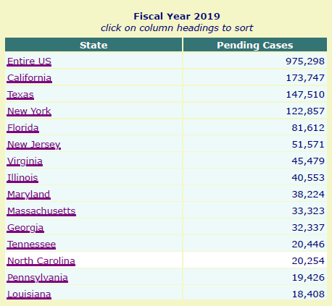
Source: Transactional Records Access Clearinghouse (TRAC), (2019, June). Immigration court backlogs. Syracuse University. Retrieved from https://trac.syr.edu/phptools/immigration/court_backlog/
Notes:
Dr. Monico
The migration we have discussed has created a backlog, which is represented in these tables on pending cases in the U.S. and in key states with large concentrations of immigrant populations. Although this data is from FY 2019, it provides a glimpse of what the Biden-Harris administration is facing.

Slide 11
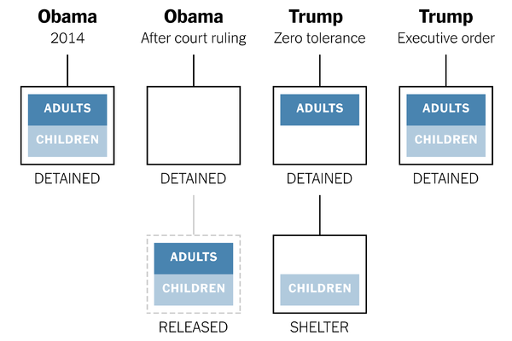
Evolution of child-family separation during Obama’s & Trump’s Administration - What comes next with Biden-Harris?
Source: The New York Times. Trump retreats on separating families, but thousands may remain apart. https://www.nytimes.com/2018/06/20/us/politics/trump-immigration-children-executive-order.html
Notes:
Dr. Monico: Using chart, explain how it is similar and different under Obama & Trump by reading the different models - explain that the court ruling refers to the Flores Settlement Agreement (FSA): children held for no more than 20 days and placed in a least security facility (child-friendly) under the care of the Office of Refugee Resettlement (ORR). The zero-tolerance immigration enforcement policy was launched on May 7, 2018, halted by court order on July 16, 2018 (7 weeks) resulted in 5,300 to 5,500 child-family separations. Trump’s executive order mentioned effectively suspended but increased apprehensions at the border, ICE raids, and other immigration crackdown operations – Monico, Rotabi & Lee (2019) and Congressional Research Service (2021) provide a detailed account of its implementation. Under COVID, the attention shifted from the U.S.-Mexican border to the country’s “interior”
Key question in: What comes next with Biden-Harris? On week 1 of the new administration, a set of executive orders are issued, including on rescinding the zero-tolerance immigration enforcement policy on January 26, 2021, The U.S. Citizenship Act of 2021 just recently introduced establishes a new system to responsibly manage and secure our border, keep our families and communities safe, and better manage migration across the Hemisphere:

Slide 12
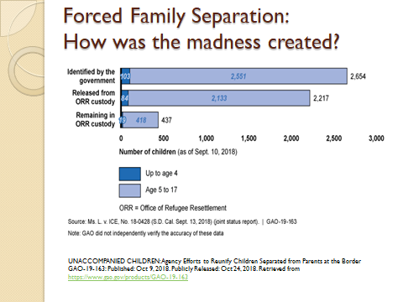
Source: U.S. Government Accountability Office (U.S. GAO). OLDER WORKERS: Other Countries' Experiences with Phased Retirement. https://www.gao.gov/products/GAO-19-16
Notes:
Dr. Monico:
Biden rescinded the Zero Tolerance policy on day 1 of his administration, ordered reunification of the 500+ children separated from their families and created a multi-stakeholder commission to carry this order. We have examined the madness that was created in 2 articles in the Journal of Human Rights and Social Work

Slide 13
Family Separation Typology since Zero-tolerance: 13 Individual Cases
(1) Separation by death: the death of toddlers, young children, youth, and adolescents during or soon after U.S. government custody;
(2) Prolonged separation: the return of children to biological parents and relatives after extended or indefinite separation;
(3) No reunification in sight: families divided before, during, and after the zero-tolerance policy with children remaining institutionalized as they are not eligible for adoption;
(4) Definite or temporary loss of parental rights: the loss of parental rights after detention of biological parents due to criminal charges (crossing without CBP inspection), the use of fraud documentation at work, or cases of domestic violence (those reported and investigated, not necessarily substantiated).
Source: Monico & Mendez-Sandoval, Geneology (2019)
Notes:
JOVANI
1) Separation by death: the death of toddlers, young children, youth, and adolescents during or soon after U.S government custody
Jakelin Amei Rosmery Caal, a 7 year-old Guatemalan girl died because of a bacterial infection while in U.S custody. Felipe Gomez Alonzo, a 8 year-old Guatemalan boy died because of Influenza B, arguably after lacking proper care while in CBP custody.
(2) Prolonged separation: the return of children to biological parents and relatives after extended or indefinite separation;
A father named Carlos and his 6 year-old daughter named Heyli from Honduras. Under the zero-tolerance policy, both Carlos and Heyli were charged with a misdemeanor. They were placed into different facilities and not regularly informed of their location or well-being. They were eventually reunited a month later but are uncertain of their legal status.
(3) No reunification in sight: families divided before, during, and after the zero-tolerance policy with children remaining institutionalized as they are not eligible for adoption;
In the summer of 2018, the Trump administration failed to reunite 102 children-separated families, with only 38 of them being successfully reunited. The reason is that parents with any minor criminal conviction, health concerns, nonbiological adult accompanies the minor or if the parent is under 18 years-old, then both the parent and child are separated at apprehension. At the time, close to 3,000 children were in custody, and it can be concluded that about 250 would be placed into a new family because their biological parents would be deported. The Trump administration claims that children under 5 years old are unlikely to reunite with their biological parents. With families failing to be reunited it has become clear that the government does not have a diligent tracking system (Soboroff 2019).
(4) Definite or temporary loss of parental rights: the loss of parental rights after detention of biological parents due to criminal charges (crossing without CBP inspection), the use of fraud documentation at work, or cases of domestic violence (those reported and investigated, not necessarily substantiated).
Encarnacion Bail Romero, a mother from Guatemala, who was arrested in 2007 for using another person’s Social Security number while working at a poultry farm in Missouri; as a result, her 6-month old son was placed with a foster family and eventually put up for adoption. A district judge proposed that the child should remain with foster parents and the biological mother had no right to see her son. After Romero lost parental rights while in custody, the Mosers became the adoptive parents. The Supreme Court of Missouri put the Mosers’ adoption on hold and a retrial for the case was granted. The court cases resulted with Romero losing her right to see her child because of abandoning her child and the Moser family’s adoption would proceed. The Mosers’ attorney claimed that Romero was an “unfit mother” and would not provide a stable life for the child. Romero had not seen her son since she was detained (Castillo 2012).
As Dr. Monico mention previously about what comes next with the Biden administration but family separation is still possible in the near future.

Slide 14
Conditions in Detention Centers
Sexual assault of women
Approximately 1,448 allegations of sexual abuse filed with ICE between 2012 and March 2018.
In 2018, a woman identified as “Maria” claims was sexually assaulted by a male guard after being released from Residential Detention Center in Texas.
“He grabbed my breasts … He put his hands in my pants and he touched my private parts,” Maria told the publication”.
https://thehill.com/blogs/blog-briefing-room/news/397382-migrant-women-describe-being-sexually-assaulted-in-ice
Sexual assault of children
In July 2018, the Office of Refugee Resettlement, received a total of 4,556 allegations of sexual abuse or sexual harassment of unaccompanied minors in U.S detention facilities.
Detailed allegations that adult staff members had harassed and assaulted children, including fondling and kissing minors, watching them as they showered, and raping them. https://www.nytimes.com/2019/02/27/us/immigrant-children-sexual-abuse.html
Source: Free the Children. ACLU races to stop ice from deleting years of records, including data on detainee deaths & sexual. https://www.freethechildrenus.org/bulletins/2020/2/20/aclu-races-to-stop-ice-from-deleting-years-of-records-including-data-on-detainee-deaths-and-sexual-assault-reports?fbclid=IwAR1Qhmadx-LQnNJpBlbn0iXur6qMiSIDa3fBMpXA5wsfPnOoE_Q2K9ZCnIQ
Notes:
JOVANI
https://www.freethechildrenus.org/bulletins/2020/2/20/aclu-races-to-stop-ice-from-deleting-years-of-records-including-data-on-detainee-deaths-and-sexual-assault-reports?fbclid=IwAR1Qhmadx-LQnNJpBlbn0iXur6qMiSIDa3fBMpXA5wsfPnOoE_Q2K9ZCnIQ
In 2019, the ACLU filed a Freedom of Information Act (FOIA) to preserve and obtain ICE records that could soon be erased thanks to a recent ruling from the National Archives and Records Administration. Erasing such records can prevent former ICE detainees who wish to take legal action against the U.S.

Slide 15
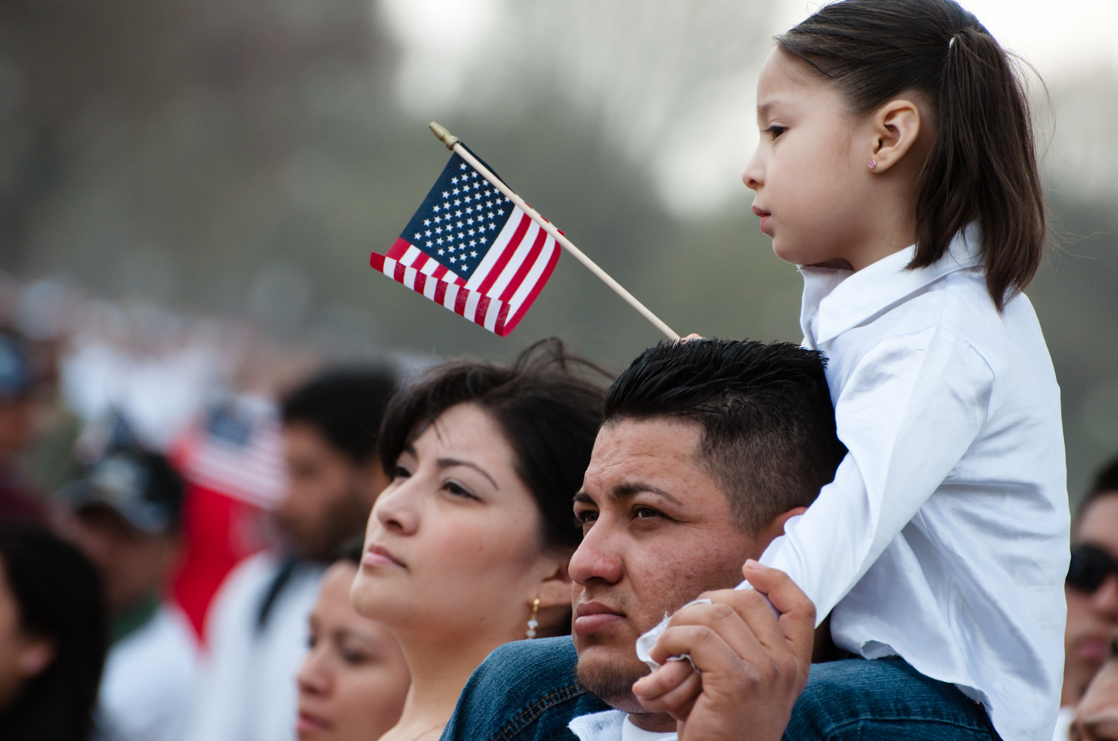
Typology of adult immigrants in detention
Detained after appearing voluntarily for annual asylum appointments.
Longtime U.S. residents who had encounter with the criminal justice system prior to being detained.
Recent arrivals; mostly asylum seekers.
Notes:
NEEMA
Informant #5 classified adult detained into 3 types. Discuss their unique characterization. Some groups were not detained under the Obama adm. were detained under the Trump-Pence adm. practices. Discuss the discriminatory system where by blacks & brown people interact with, the criminal justice system and mental health issues that result in detainment of some immigrants. Discuss how the enactment of “Remain in Mexico laws” hv affected this group & how they contribute to asylum hearings in Mexico, often under dangerous conditions

Slide 16
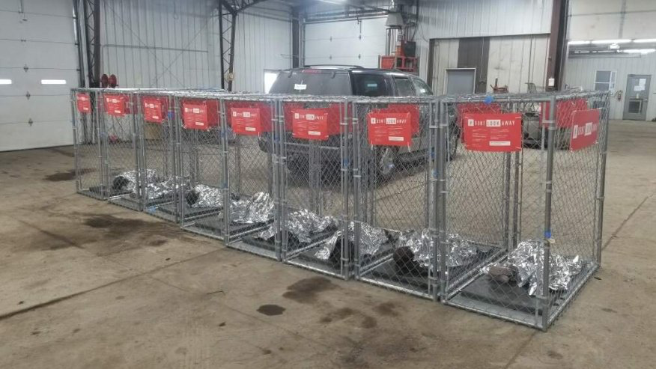
Characterization of minors in government custody
Minors in shelters before placed under Office of Refugee Resettlement (ORR)
Children and teenagers placed in secure facilities run by ORR
Teenagers placed in long term foster care with non profit organizations
Minors placed in detention facilities with their families
Notes:
Immigrant children (0-12) and teenagers (13-17) under customs custody or under the care of ORR. Flores Settlement Agreement (FSA): held no more than 20 days and placed in a least security facility (child-friendly)

Slide 17
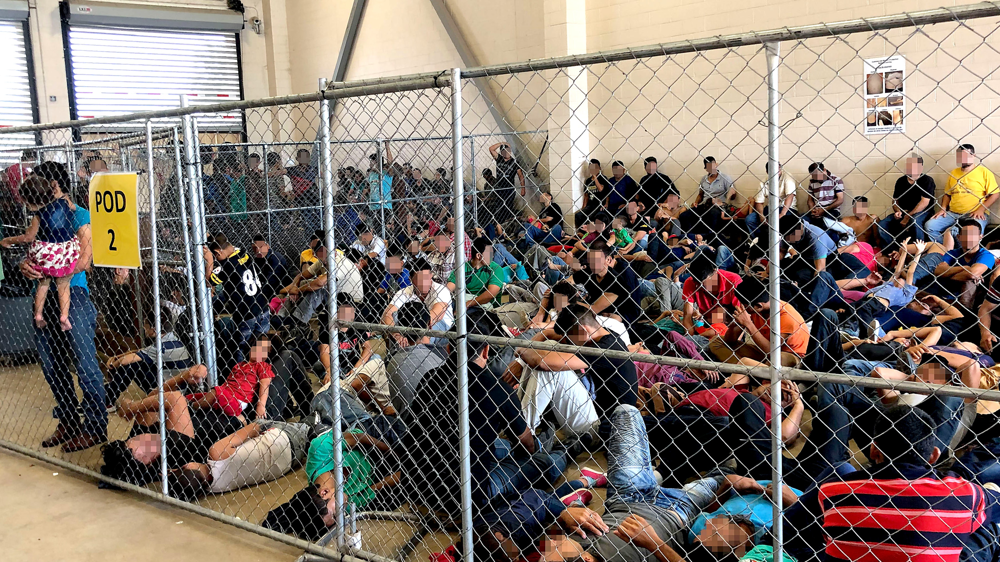
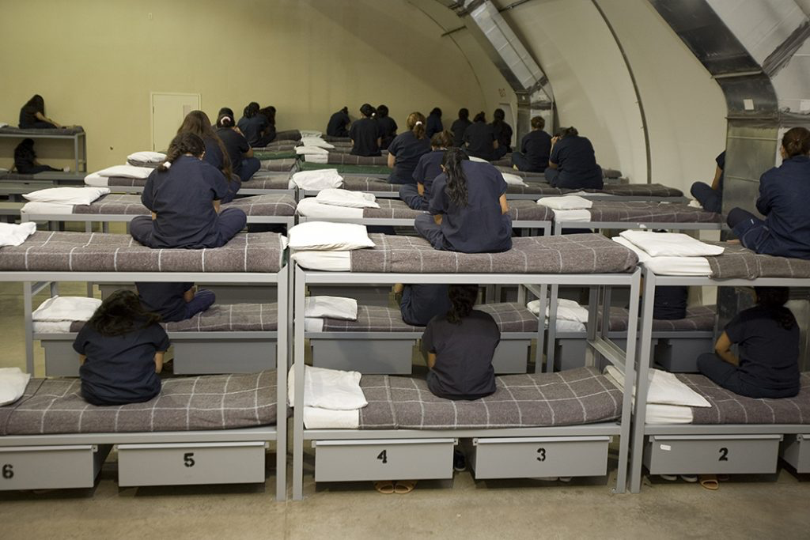
Characterization of Detention Facilities
Federally owned detention facilities
County jails
Privately owned prisons
Notes:
NEEMA
1. Talk about mass incarceration moved to immigrants being the growing population first. 2. Discuss 3 characterization of Det.facilities 3. Reinstate informant # 5 quote that all of these facilities whether federally or privately run, it is jail, it is detention hence mental health issues are exacerbated on already traumatized and vulnerable population 4. Mention Informant #5 emphasis that Under the Trump-Pence Adm policies are not driven by what is best interest of children

Slide 18
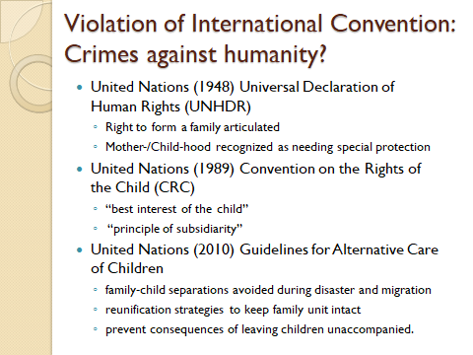
Notes:
Introduce international convention and ask the question for discussion: Are these crimes against humanity?
UN (1948): Universal declaration of human rights:
“ A common standard of achievements for all peoples and all nations. It sets out, for the first time, fundamental human rights to be universally protected.” (https://www.un.org/en/universal-declaration-human-rights/)
Article 25: discusses the importance of rights to a standard of living that is adequate for health and well-being. It also discusses the importance of motherhood and childhood are entitled to special care and assistance.
UN (1989): Convention on the Rights of the Child
International agreement setting out the civil, political, economic, social and cultural rights of every child, regardless of their race, religion or abilities. (https://www.savethechildren.org.uk/what-we-do/childrens-rights/united-nations-convention-of-the-rights-of-the-child)
Article 3: Welfare institutions, court of law, legislative bodies should be in primary consideration of the child
UN (2010): Guidelines for Alternative Care of Children
International instruments regarding the protection and well-being of children who are deprived of parental care or who are at risk of being so.
Importance of avoiding family separation, promoting family reintegration, framework of care provision and alternative care

Slide 19
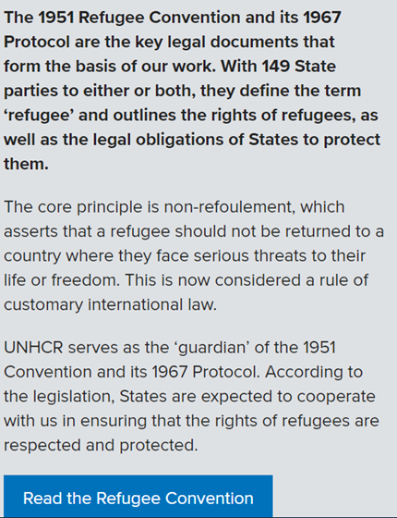
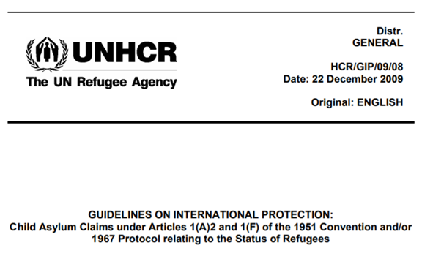
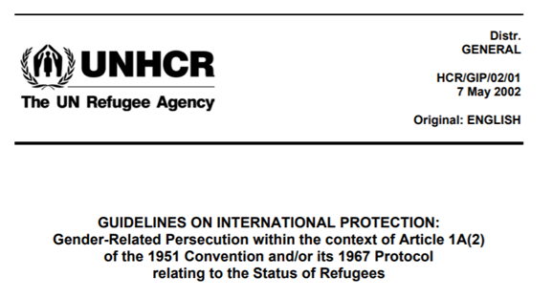
Other International protections instruments
https://www.unhcr.org/en-us/publications/legal/50ae46309/guidelines-international-protection-8-child-asylum-claims-under-articles.html
https://www.unhcr.org/en-us/1951-refugee-convention.html
https://www.unhcr.org/3d58ddef4.html
Notes:
Dr. Monico - explain the international protections instruments listed but mentioned that there are many others

Slide 20
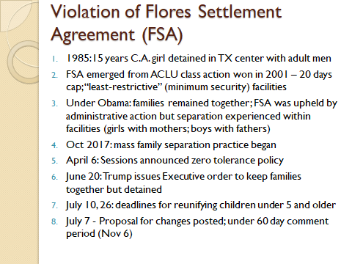
Notes:
Dr. Monico - explain the FSA

Slide 21
Regulatory and administrative framework
The 400+ immigration executive actions during the Trump-Pence Administration have profoundly transformed the immigration system, resulting in restrictive and punitive immigrant policies and practices (MPI report)
The U.S. Citizenship Act of 2021 establishes a new system to responsibly manage and secure our border, keep our families and communities safe, and better manage migration across the Hemisphere (WH Fact sheet)
https://www.migrationpolicy.org/sites/default/files/publications/MPI_US-Immigration-Trump-Pence-Pence-Presidency-Final.pdf
https://www.whitehouse.gov/briefing-room/statements-releases/2021/01/20/fact-sheet-president-biden-sends-immigration-bill-to-congress-as-part-of-his-commitment-to-modernize-our-immigration-system/
Notes:
Dr. Monico -
July 2020 Migration Policy Institute Report: In nearly four years, the administration of President Donald J. Trump has dismantled and reconstructed many elements of a U.S. immigration system that was last reformed in 1996. Humanitarian protections have been severely diminished. From the original travel ban for visitors from Muslim-majority countries to termination of the Deferred Action for Childhood Arrivals (DACA) program, overlapping policies narrowing asylum at the U.S.-Mexico border, curbs on legal immigration and access to benefits, deployment of active-duty military to the border, changed interior enforcement policies and reshaping of the immigration courts, the report describes each action in brief, by date and with reference back to the original source. The report examines Immigration enforcement at the border and in the U.S. interior; Asylum and refugee systems and other humanitarian programs Justice Department actions, including in the immigration courts; Changes to vetting and visa processes at the State Department, U.S. Citizenship and Immigration Services and the Labor Department; Pandemic response.
MPI researchers Sarah Pierce and Jessica Bolter conclude. “Thus, regardless of whether the pendulum swings in the direction of policies that favor revived immigration, the restoration of humanitarian protections and more targeted enforcement, the Trump presidency will have lasting effects on the U.S. immigration system long after his time in office.”
US. Citizenship Act of 2021
FIRST proposes keep families together
(1) Create an earned roadmap to citizenship for undocumented individuals without criminal records with current temporary statuses: Dreamers, TPS holders, and immigrant farmworkers who meet specific requirements are eligible for green cards immediately under the legislation.
(2) Create a family-based immigration system by clearing backlogs, recapturing unused visas, eliminating lengthy wait times, and increasing per-country visa caps. It also eliminates the so-called “3 and 10-year bars,” and other provisions that keep families apart. Seeks to eliminate discrimination facing LGBTQ+ families. It also provides protections for orphans, widows, children, and Filipino veterans who fought alongside the United States in World War II.
(3) NO BAN Act that prohibits discrimination based on religion and limits presidential authority to issue future bans. The bill also increases Diversity Visas to 80,000 from 55,000.
(4) new funding to expand programs to promote integration and inclusion, increase English-language instruction, and provide assistance to individuals seeking to become citizens.
(5) graduates of U.S. universities with advanced STEM degrees to stay in the United States; improves access to green cards for workers in lower-wage sectors; and eliminates other unnecessary hurdles for employment-based green cards. The bill provides dependents of H-1B visa holders work authorization, and children are prevented from “aging out” of the system.
(6) Workers who suffer serious labor violations and cooperate with worker protection agencies will be granted greater access to U visa relief. The bill protects workers who are victims of workplace retaliation from deportation in order to allow labor agencies to interview these workers.
ALSO, establishes “smarter” border controls:
Supplement existing border resources with technology and infrastructure.
creates a Border Community Stakeholder Advisory Committee, provides more special agents at the DHS Office of Professional Responsibility to investigate criminal and administrative misconduct. Directs the Government Accountability Office (GAO) to study the impact of DHS’s authority to waive environmental and state and federal laws to expedite the construction of barriers and roads near U.S. borders
crackdown on smuggling and trafficking networks who are responsible for the exploitation of migrants.
ALSO, seeks to address root causes in CANT countries
President’s $4 billion four-year inter-agency plan to address the underlying causes of migration in the region, including by increasing assistance to El Salvador, Guatemala, and Honduras, conditioned on their ability to reduce the endemic corruption, violence, and poverty that causes people to flee their home countries.
re-institutes the Central American Minors program to reunite children with U.S. relatives and creates a Central American Family Reunification Parole Program
expands family case management programs, reduces immigration court backlogs, expands training for immigration judges, and improves technology for immigration courts. Funding is authorized for legal orientation programs and counsel for children, vulnerable individuals, and others when necessary to ensure the fair and efficient resolution of their claims. The bill also provides funding for school districts educating unaccompanied children, while clarifying sponsor responsibilities for such children.
eliminates the one-year deadline for filing asylum claims and provides funding to reduce asylum application backlogs. It also increases protections for U visa, T visa, and VAWA applicants, including by raising the cap on U visas from 10,000 to 30,000.
https://www.whitehouse.gov/briefing-room/statements-releases/2021/01/20/fact-sheet-president-biden-sends-immigration-bill-to-congress-as-part-of-his-commitment-to-modernize-our-immigration-system/

Slide 22
Some conclusions; lessons to be drawn
U.S. not meeting international standards & conventions protecting migrants, children & other special populations, during global health emergency
Immigrant prison industrial complex: Systematic, organized operations amounting to crimes
Government’s role & responsibilities have changed, still lack of transparency & accountability
Health-related and humanitarian concerns will be long lasting: aggravated under COVID-19
Neurological, psycho, emotional, social long-term impact on affected children and youth
Profound effect on caregivers and transnational families: ambiguous loss & unresolved grief
impact on immigrant/refugees/asylum seekers and general population
Notes:
Dr. Monico
The flurry of executive orders and policy memos during the months of the Biden-Harris administration and the comprehensive immigration reform promises are hopeful signs of change. How quickly and how well the new administration will dismantle hundreds of executive orders of the past Administration is undetermined. It is uncertain how apprehensions at border and in the country’s interior and the processing of cases of asylum applicants will be managed after the MPP suspension. The judicial challenges to the Biden-Harris Administration's first 100-day suspension of deportation at the border, and the unilateral action of the Mexican government to reject the return of asylum seekers from the U.S. have made it difficult to predict the direction of immigration policy and practices. While the future policies adversely impacting immigrants in the U.S. is unknown, the basic framework of the detention and removal process for children and adults, remains the same, at least for now.
See Biden-Harris executive orders: https://www.federalregister.gov/presidential-documents/executive-orders/joe-biden/2021

Slide 23
End-point – Where do we go from here?
How does the presentation refer to your personal experience?
How does the presentation refer to the professional work you do?
What are the key takeaways you have from this presentation?
How do you plan to use what you have learned today?

Slide 24
Works Cited
Council on Foreign Relations. "U.S. detention of child migrants." N.p., 28 Aug. 2014. Web. <https://www.cfr.org/backgrounder/us-detention-child-migrants>.
Free the Children. "ACLU races to stop ice from deleting years of records, including data on detainee deaths & sexual — Free the children —bulletins and news." N.p., 20 Feb. 2020. Web. <https://www.freethechildrenus.org/bulletins/2020/2/20/aclu-races-to-stop-ice-from-deleting-years-of-records-including-data-on-detainee-deaths-and-sexual-assault-reports?fbclid=IwAR1Qhmadx-LQnNJpBlbn0iXur6qMiSIDa3fBMpXA5wsfPnOoE_Q2K9ZCnIQ>.
Lawfare. "Who’s really crossing the U.S. border, and why they’re coming." N.p., 31 Oct. 2019. Web. <https://www.lawfareblog.com/whos-really-crossing-us-border-and-why-theyre-coming>.
The New York Times. "Trump retreats on separating families, but thousands may remain apart." The New York Times - Breaking News, US News, World News and Videos. N.p., 21 June 2018. Web. <https://www.nytimes.com/2018/06/20/us/politics/trump-immigration-children-executive-order.html>.
Office for the Coordination of Humanitarian Affairs (OCHA). "Natural Disasters In Latin America and The Caribbean." N.p., 2019. Web. <https://www.humanitarianresponse.info/sites/www.humanitarianresponse.info/files/documents/files/2000-2019-ocha-desastres_naturales2.pdf>.
Transactional Records Access Clearinghouse (TRAC) - Comprehensive, independent, and nonpartisan information on federal enforcement, staffing and funding. "Immigration court backlog tool: Pending cases and length of wait in immigration courts." N.p., 2021. Web. <https://trac.syr.edu/phptools/immigration/court_backlog/>.
U.S Customs and Border Protection. "Southwest border migration FY 2020." N.p., 14 Dec. 2020. Web. <https://www.cbp.gov/newsroom/stats/sw-border-migration>.
U.S. Government Accountability Office (U.S. GAO). "OLDER WORKERS: Other Countries' Experiences with Phased Retirement." U.S. Government Accountability Office (U.S. GAO). N.p., 13 Mar. 2019. Web. <https://www.gao.gov/products/GAO-19-16>.
United Nations High Commissioner for Refugees. Children on the run. N.p., 2014. Web. <https://www.unhcr.org/en-us/children-on-the-run.html>.

